Slide 1
Avances a Mitad de la Década sobre Propuestas de Investigación en Raza y Etnicidad de la Oficina del Censo de los EE.UU. Dr. Fabián Romero División de Población Para su presentación en el Seminario Internacional sobre estadísticas étnico-raciales recientes en Colombia y América Latina Noviembre 19-21, 2014 – Cali, Colombia
Notes:
Thank you, [seminar’s MC]
It’s an honor for me to take part in this conference!
And it’s great to be here in Cali representing the U.S.
Census Bureau in this seminar, with so many experts
from all over the world.
The Census Bureau’s 2015 National Content Test
is the continuation of ongoing testing activities
to research innovative methods
for reducing the cost of the 2020 Census
(2010 Census cost more than $13 billion),
while maintaining our commitment
to a high quality census.
This presentation will update you
on the Census Bureau’s mid-decade research plans
for race and ethnicity.

Slide 2
Pregunta(s) sobre Raza y Origen Hispano
Experimento de Cuestionarios Alternativos del Censo de 2010 (AQE)
Afro-Latinos – tabulaciones especiales
Cooperación con grupos de interés
Investigación y pruebas de mediados de década
2
Notes:
During the 2010 Census, we conducted extensive research
on race and ethnicity.
I’d like to take a couple minutes to provide an overview
of the 2010 Census Alternative Questionnaire Experiment
research on race and Hispanic origin,
which we refer to as the “AQE.”
This experiment produced special tabulations for the
Afro-Latino population that I am going to refer to shortly.
After that, I will update you on some of the outreach
and stakeholder engagement discussions we have had
over the past couple years.
And finally, I will present an overview of the key dimensions
that we are testing for race and ethnicity
in our mid-decade research.
I will specifically discuss some of the revised question designs
that we are examining in the 2015 Test.

Slide 3
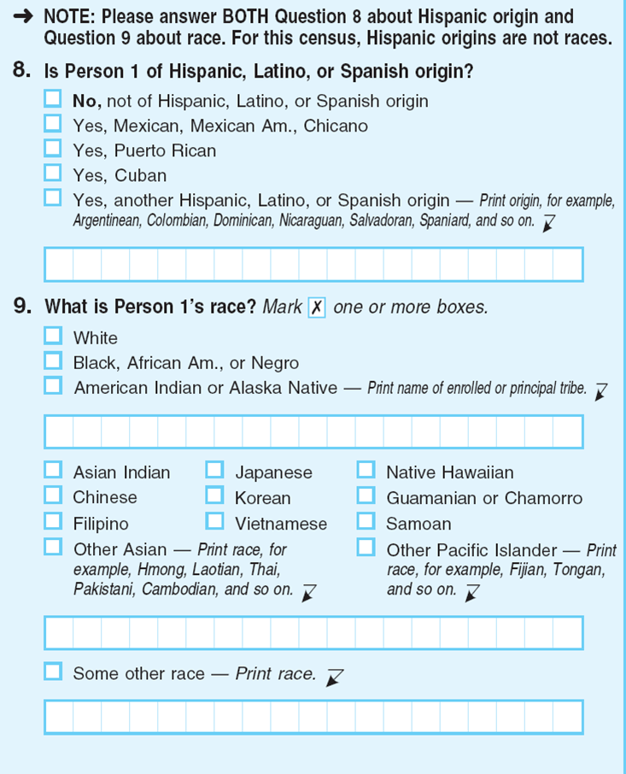
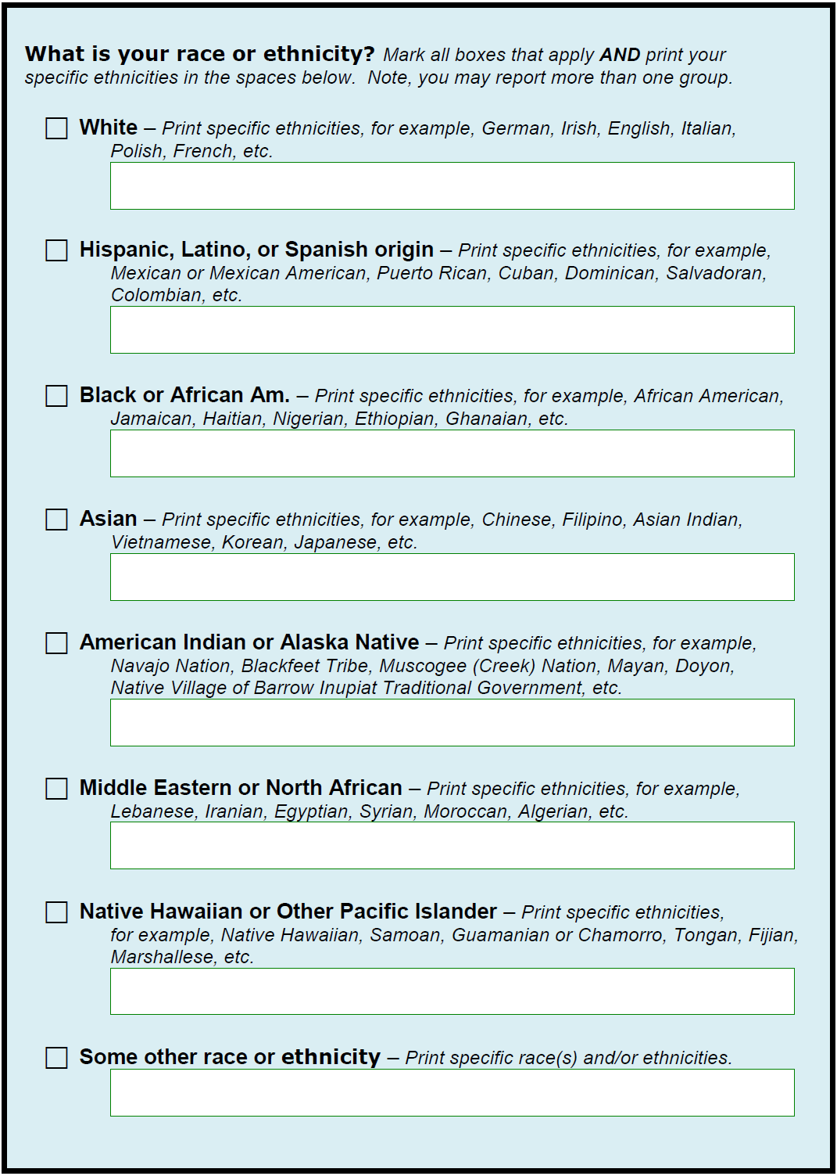
Estrategias de Diseño del AQE: 2010
Preguntas separadas
Pregunta combinada
X
X
X
Afro-Latino
Garífuna
X
X
Cubano
X
X
Mexicano
3
3
Notes:
The 2010 AQE was the most comprehensive
research effort on race and Hispanic origin
ever undertaken by the Census Bureau.
It was comprised of included three components:
with half a million households for a mail out mail back sample;
a telephone reinterview with one-in-five of those households;
and a series of 67 focus groups with about 800 people
across the United States – including Alaska, Hawaii, and Puerto Rico.
We want to ensure you have a high-level understanding
of the experimental research approaches we explored in the 2010 AQE --
both to provide context for the results, and also the foundation
for the research refinements we are exploring now.
So here on the slide, the image on the left presents
one example of the two separate questions approach.
This approach is the one that was used in 2010.
Our research shown that over 40% of Hispanic respondents did not
report being of one of the federally recognized race categories.
Those respondents either left the race question blank or gave us a “some other race”
response; We found that. Among Hispanics, “Some Other Race” responses
are often other Hispanic terms, like in the example on the screen.
During re-interviews, we found that this was the case because Hispanic
Respondents often did not identify with any of the officially recognized
racial categories.
The image on the right presents an example of one of the
experimental combined question approaches
that we tested in the 2010 AQE, and that was designed to
improve our data.
Here, I am presenting two instances of responses of Afro-Latinos.
First, I show how Afro-Latinos can report their origin in the
Hispanic write-in line, and second, how an specific Hispanic
origin could be reported in the Black write-in line. In both
instances, the race and Hispanic origins of the respondents are
preserved.
The AQE research sought to understand how and why
people identify themselves in different ways and different contexts.
We tested different questionnaire strategies with four goals in mind:
Increasing reporting in the race and ethnic categories as defined
by the U.S. Office of Management and Budget (OMB),
2. Decreasing non-response,
3. Increasing the accuracy and reliability of the results, and
4. Eliciting detailed responses for all racial and ethnic communities
(e.g., Chinese, Mexican, Jamaican, etc.).
The results of the AQE supported all of these objectives.
Additionally, many individuals across communities
liked the combined question approach
as they felt it presented equity and balance to the different categories.

Slide 4
Principales Hallazgos del AQE: 2010
Resultados de la Pregunta Combinada
No cambió los resultados para Hispano, Negro o Africano Americano, Indio Americano o Nativo de Alaska, Asiático, o para Nativo de Hawái u otra Isla del Pacífico
Produjo tasas de falta de respuesta más bajas
Reflejó mejor la “identidad propia”, según las re-entrevistas
4
Notes:
4
There was a concern in the Afro-Latino community that the
implementation of a combined question would result in the
Under-counting of this group. They thought that Afro-Latinos
Would often not report being Hispanic AND Black.
However, in our research, there were no significant differences
between any of the 17 panels tested in the AQE in Hispanics
reporting as Black, whether separate or combined.
• Combining race and ethnicity into one question
did not change the proportion of Hispanics, Blacks,
American Indians and Alaska Natives, Asians,
or Native Hawaiians and Other Pacific Islanders.
Some other findings from the AQE include:
• That while the separate questions still had S
ome Other Race as high as 7 percent, the combined
question designs yielded a substantially reduced
Some Other Race population under half a percent.
And “White” dropped to levels
reflecting the “Non-Hispanic White” population
that we see in traditional separate question approaches.
Overall, when a “Hispanic” category is provided
as a response option with the combined question,
Some Other Race becomes one of the smallest response categories,
demonstrating that a combined question approach is more in-line
with how Hispanic respondents view themselves.
• Another major finding was that the combined question
yielded lower item nonresponse rates
than the two separate questions approach.
• The combined question increased reporting of detailed responses for most groups,
but decreased reporting for others.
• The combined question better reflects self-identity.
The reinterview study and focus group research confirmed that these reporting patterns
were a closer reflection of how people self-identify.
• Across the focus groups, participants commented that all race and ethnic groups
were not treated equally in the 2010 Census and felt that all groups should be treated fairly and equitably.
• Finally, one common theme across communities was that many respondents liked
the combined question approach, and felt it presented equity to the different categories,
as each major group received a checkbox, with examples,
and a write-in line, where detailed responses could be provided.

Slide 5
Cooperación y Discusiones con Grupos de Interés y Asesores
Comité Consultivo Nacional de la Oficina del Censo
Comité interinstitucional de agencias federales
Amplia gama de comunidades, organizaciones y líderes de grupos étnicos y raciales
Académicos e investigadores expertos
5
Notes:
5
Our research team has been involved in ongoing dialogues,
outreach discussions, and engagement with many diverse
advisors, stakeholders and external experts since the
conception of the AQE research back in 2008.
We worked with them throughout the design phase,
implementation, and release of the results,
and continue to now as we make our next steps towards 2020.
For example, over the past year, members of our National Advisory Committee
met with us to discuss our race and ethnicity research and future plans,
and they encouraged us to continue our research
on the both the separate and combined questions,
alternative question wording, instructions, and terminology,
and the testing of a distinct category
for respondents of Middle Eastern, North African, and Arab heritage.
Additionally, earlier this year, OMB created a federal interagency working group
on race and ethnicity to discuss research and possibly make recommendations
on important race and ethnicity issues.
We also continue a long tradition of outreach and dialogue
with myriad racial and ethnic communities, as well as academic scholars and expert researchers.
• For example, we met with the Arab American Institute
and leading Middle Eastern and Arab American scholars, activists, and organizations
about their request for a separate classification and “MENA” category.
• We met with members of the National Council of Asian & Pacific Americans
to discuss ways in which to collect important disaggregated data
for detailed Asian and Pacific Islander groups.
• We met with leaders and research experts in the Latino community at a national summit
sponsored by the National Association of Latino Elected & Appointed Officials
to discuss AQE findings, race reporting among Hispanics,
and ways to improve data on race and ethnicity.
• Additionally, we met with a broad national coalition of researchers and civil rights experts
to discuss the topic of race, ethnicity, and civil rights at a forum
sponsored by the Leadership Conference on Civil & Human Rights.
• And this fall, we met with researchers and leaders in the Afro Latino community
to take part in a panel discussion on the importance of race and ethnic data and identity
for the Afro-Latino population.

Slide 6
Metas Para Mediados de Década sobre la Investigación de Raza y Origen Hispano
Cuatro Dimensiones Clave a Explorar
Preguntas separadas vs. pregunta combinada
“Del Medio Oriente o el Norte de África”, (MENA) categoría
Redacción de instrucciones y terminología
Diseños basados en la red para mejorar la comprensión de las preguntas y optimizar el reporte detallado de grupos étnicos o raciales
6
Notes:
6
This presentation provides an update
on our mid-decade testing plans
to refine our designs for race and ethnicity,
which follow upon the successful strategies
of the 2010 Census AQE.
With respect to race and ethnicity,
the Census Bureau has been developing refinements
that focus on several key dimensions
for improving the questions on race and Hispanic Origin.
These dimensions include:
Question format - as we are continuing research
on the separate questions approach and the combined question approach,
Response categories - by exploring how to collect and tabulate data
for respondents of Middle Eastern, North African, and Arab heritage
Wording of instructions and question terminology -
through examining ways to optimize detailed reporting
and to improve respondent understanding of options
to report multiple race and ethnic groups
and using Web-based technology -
e.g., internet, smart phone, tablet, telephone,
to enhance question designs
and optimize reporting of detailed racial and ethnic groups.

Slide 7
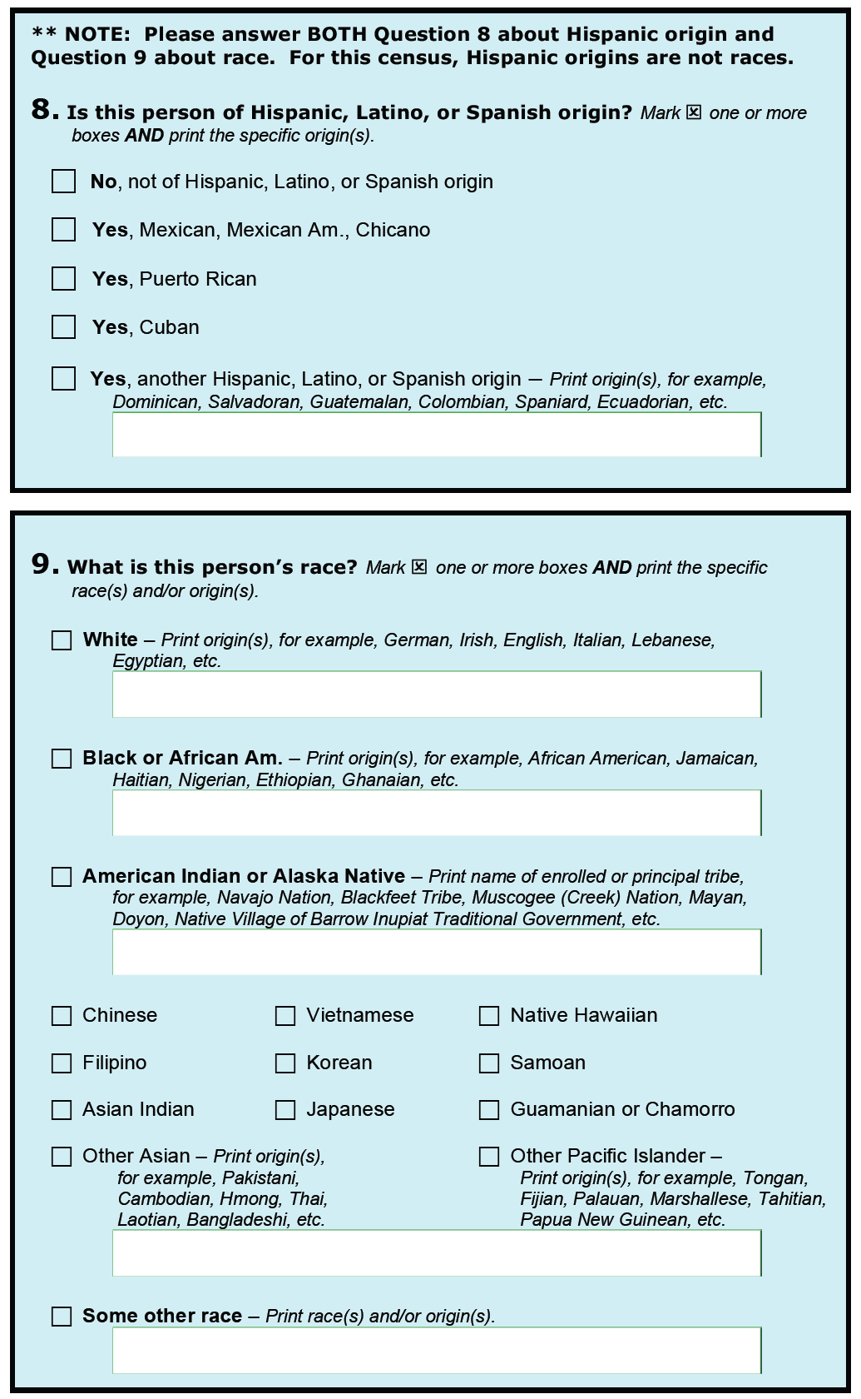
Separadas vs. Combinada
7
Notes:
7
When the 2010 AQE research was conducted,
the Census Bureau emphasized
that research strategies
were being tested
and that we did not intend
to pick the 2020 Census question
ten years ahead of time.
We also advised
that we expected to conduct more research during the decade
to build upon the successful strategies
of the 2010 AQE
in order to make recommendations
and determination for the 2020 Census.
The 2015 Test will enable us
to further evaluate
the separate questions approach
and
the combined question approach
to determine how the questions perform
in new web-based data collection methods
using the internet, smartphone, telephone,
and in-person response options.
What you see here are some of the revisions we are testing.
The results and findings from the 2015 research
will inform recommendations to OMB
on question design format
(separate vs. combined)
for the 2020 Census.

Slide 8
Instrucciones y Términos
Redacción de Instrucciones:
Marque [X] una o más casillas.
Marque todas las casillas que apliquen[…]
Note que usted puede reportar más de un grupo.
Terminología Alternativa:
“Raza”, “Etnicidad”, “Origen”
¿Qué categorías lo describen?
8
Notes:
8
The 2015 Test will also evaluate the use
of alternative instruction wording and terminology
for improving respondent understanding of the question
and reporting options.
[ CLICK ] Recent qualitative focus groups
and cognitive research found that
the instruction to “Mark [X] one or more boxes”
is frequently overlooked by respondents.
The research found that some respondents stopped reading the instruction
after noticing the visual cue [X]
and proceeded directly to do just that -- mark a box –
overlooking the remainder of the instruction.
We are testing alternative instruction wording to “Mark all boxes that apply”
And also Noting that people “may report more than one group.”
in an attempt to improve the clarity of the question
and make it more apparent that more than one group may be selected.
[ CLICK ] We will also evaluate the use of different terminology
to describe the question and concepts of "race," "ethnicity," and "origin."
Recent qualitative focus groups and qualitative research
found that the term “origin” is confusing or misleading to many respondents,
who may think it is asking about where they immigrated from or where they were born.
Two alternative options are being explored in cognitive testing and usability research.
One approach tests the use of the term "ethnicities" along with "race"
(e.g., "Print the specific races(s) and/or ethnicities...").
The other approach tests the removal of the terms altogether
from the question stem, instructions, and examples.
Instead, a general approach asks, "Which categories describe this person?"
The exact terminology to be used for the alternative version
is pending cognitive testing and usability results later this year,
which will inform the wording to be used in the 2015 Test.

Slide 9
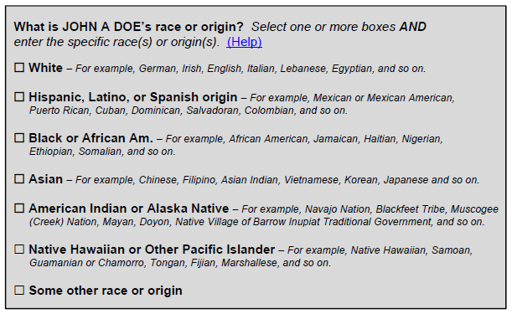
Diseños Basados en la Red
Pantalla Inicial para Raza y Etnicidad



9
9
Notes:
9
In addition, with the advantage of new technology
to collect data via web-based designs,
we will also be testing a combined question
with detailed checkboxes
for soliciting detailed racial and ethnic origins.
This approach will provide
a series of detailed checkboxes
and write-in spaces
for each of the OMB categories
to help collect data for detailed groups
(e.g., Samoan, Iranian, Filipino,
Jamaican, Puerto Rican, Irish, etc.).
This design example emphasizes some of the new options
that we are exploring for our internet and electronic data collections.
On the initial screen, a combined question collects data
on the major OMB categories.
For each of the major OMB categories:
a checkbox is provided;
and examples are shown for the six largest detailed groups
representing the geographic diversity
of the OMB race/ethnic group’s definition.
[ CLICK ]
So here, for example,
the respondent marks
Hispanic, Latino, or Spanish
[ CLICK ]
They also mark
Black or African American
[ CLICK ]
and they mark
Asian…

Slide 10
Diseños Basados en la Red
Pantallas Subsecuentes Para Respuestas Detalladas
Pantalla para Hispano,
Latino o Español
Pantalla para Negro o Afroamericano
Pantalla para Asiático
Select all boxes that apply and/or enter detailed ethnicities in the space below.
HISPANIC, LATINO, OR SPANISH
Mexican or Mexican American
Puerto Rican
Cuban
Dominican
Salvadoran
Colombian
Enter other ethnicities below (for example,
Spaniard, Honduran, Ecuadorian, etc.)
Select all boxes that apply and/or enter detailed ethnicities in the space below.
BLACK OR AFRICAN AM.
African American
Jamaican
Haitian
Nigerian
Ethiopian
Ghanaian
Enter other ethnicities below (for example,
South African, Barbadian, Liberian, etc.)
Select all boxes that apply and/or enter detailed ethnicities in the space below.
ASIAN
Chinese
Filipino
Asian Indian
Vietnamese
Korean
Japanese
Enter other ethnicities below (for example,
Pakistani, Cambodian, Hmong, etc.)
Afro-Latino
10
10
Notes:
10
For any category selected, a subsequent internet screen
presents several detailed checkbox groups
and a dedicated write-in area
to collect additional detailed responses.
[CLICK ] So for example,
this screen would collect detailed responses
for specific Hispanic groups,
such as Mexican, Puerto Rican, Cuban,
Dominican, Salvadoran, Colombian, etc.
[CLICK ] And in similar fashion, a screen
would collect detailed responses for specific Black groups,
such as African American, Jamaican, Haitian,
Nigerian, Ethiopian, Ghanaian, etc…
Maybe respondents will like that report that they are
Hispanic or Afro-Latinos in this category. With this question
design, they would be able to do so.
Additional screens would collect data for other categories
that were selected by the respondent.
[CLICK ] For example, if they selected Asian,
a follow-up screen would collect detailed responses for specific Asian groups,
such as Chinese, Filipino, Asian Indian,
Vietnamese, Korean, Japanese, etc.
These web-based designs enable us
to do so much more than paper questionnaires,
and we believe these new design approaches
will help us collect data
for both the broader OMB categories,
as well as elicit detailed responses across all groups.

Slide 11
¿Tiene comentarios o sugerencias?
Fabián Romero, Ph.D.
Demographic Statistician Population Division
301.763.9939
fabian.romero@census.gov
11
11
Notes:
I hope this presentation has given you a good overview
of our 2020 Census content testing plans.
I have listed my contact information on this slide.
If you have any questions, please let me know. I’ll
Be happy to answer them. Or, if you want to know
In more detail about the AQE or its supplemental
research, I can direct you to the original sources.
I look forward to your feedback and your questions.
Thank you.

