Slide 1
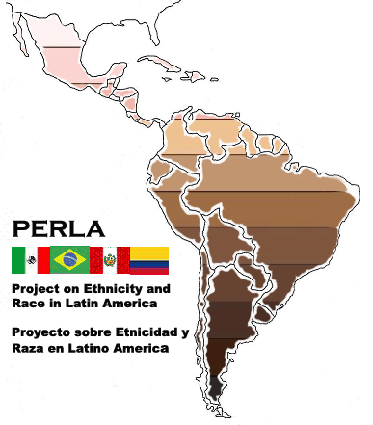
http://perla.princeton.edu/
Notes:
Note website, thank Mariana Campos
Also thank René Flores and Liza Steele for collaborating on articles and for help in producing this power point presentation. Will show slides from both our projects.
Also, have done research first on racial identitification, public opinion before venturing into into stratification.

Slide 2
2014

Slide 3
PERLA
Multinacional con Colaboradores de Brasil, Colombia, México, Perú y Estados Unidos
Multidisciplinar
Baseados en Encuestas/”Surveys” en 2010 Con Representación Nacional
Dos Estagios:
1. Modulo Étnico en el Barómetro de las Américas en 8 a 25 Países (LAPOP)
2. Encuestas en Profundidad en Brasil, Colombia, México y Perú
Sobre-Amuestras
Notes:
Survey accompanies new interest on the topic in Latin America and the addition of race and ethnicity questions in many national censuses, for the first time.
LAPOP SURVEYS
Also known as America’s Barometer
Face to Face Surveys of 24 Countries in the Americas, based at Vanderbilt University
Political-Science Focus
PERLA Ethnicity Module in 2010 adds:
-ethnoracial identification and skin color measures in 23 countries
-ten ethnicity/race and class origin items in 8 countries
Context of Multiculturalism and New Race Consciousness
But with almost no Data, New Censuses
Brazil exception
In-depth Ethnicity and Race Surveys in Four Countries with about 100 items
National Probability Samples Brazil (1000 cases) Colombia (1050 cases) Mexico (1000 cases) Peru (1500 cases)
Over-Samples Afro-Colombians (500 cases) Mexican Indigenous (500 cases) Afro-Mexicans (400 cases)

Slide 4
Temas de las Encuestas
Clasificación Etnoracial
Desigualdades Etnoraciales
Percepciones de Discriminación
Opinión Publica Actitudes Raciales
Movimientos Sociales
Políticas Publicas Engráciales

Slide 5
Preocupaciones
Diversidad de Países con Formaciones Etnoraciales Distintas
Investigar Afro descendientes e Indígenas
Empíricamente Testar Desacuerdos/Dudas en Nuestras Discusiones
Entender Implicaciones de Múltiples Maneras de Clasificación Etnoracial para Conteo Poblacional y Desigualdades
Medir Color de Piel-Una Variable Escondida

Slide 6
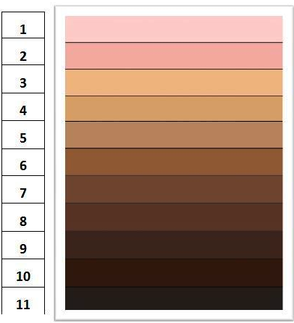
Color Palette
Notes:
Full range of color continuum
People have these in their heads
Skin color discrimination is widely recognized in Latin America
INTERVIEWER INSTRUCTIONS FOR USE OF COLOR PALETTE
Color Palette based on actual skin colors
Interviewers rated skin color of respondents before the interview
Skin color based on facial color
Interviewers directed to be familiar with palette and never show it to respondents
Interviewers explained why we are interested in skin color, especially as a meaningful social category that is rarely discussed
(Often used in U.S. surveys)
Cultural and Biological Race Mixture. Culture is consensus. I think one can easily argue that there was more much more biological race mixture across the population than the United States because
- high sex ratio during colonization
- more intermarriage in the twentieth century (based on Brazil data)
- relatively large black and indigenous populations and small white population so that chance of whites encountering nonwhites are greater (data on number of European immigrants?)
- relatively small number of European immigrants compared to US, even at height of mass immigration (except perhaps in Southern Brazil)
- wide skin color varation among the general population in all four countries
Mixture in black population (by far, largest part of nonwhite population) so that intermediate categories (mulatos) kept in black category but one drop rule kept it limited to that category while white category was considered pure (although sometimes violated).
Changing with large scale immigration of latinos and asians in the United States, so the Latin American experience may be important here

Slide 7
Inconsistencias en la Mediación Etnoracial
Clasificación Etnoracial en los Censos e en Encuestas es Medida de Varias Maneras y depende de la pregunta y las categorías usadas y quien responde

Slide 9
Ejemplos de Preguntas de Censos y Categorias de Respuestas
Preguntas:
Su Color o Raza es….? (Brasil)
Como Ud. Se Considera…? (Ecuador)
A que grupo etnico (pueblo) pertenece? (Guatemala)
Segun su cultura, pueblo or razgos fisicos, Ud. es o se considera?….(Colombia)
Ud. Pertenence a la…. Cultura? (Costa Rica)
Ud. O Alguno de sus antepasados es…? (Uruguay, Argentina)
Cual es su color de Piel? (Cuba)
Categorias de Respuesta:
Para indigenas, indigena o grupo etnico o idioma hablado
Para Afrodescendientes: negro, mulato, pardo afrodescendiente, Afro-(Pais),, preto, raizal, moreno? Indio?
Notes:
Concern about local variations in ianguage and terms used but also politics of course.
Census data is better of course but often not yet accessible. Project to begin to exploit it next year on the IPUMS.
Always self identification today

Slide 10
1. La Mediación de Raza tiene Implicaciones para La Proporción Indígena y Afro descendiente

Slide 11
Indígenas en México

Slide 12
Quantos Negros no Brasil?
Figure 5.2

Slide 13
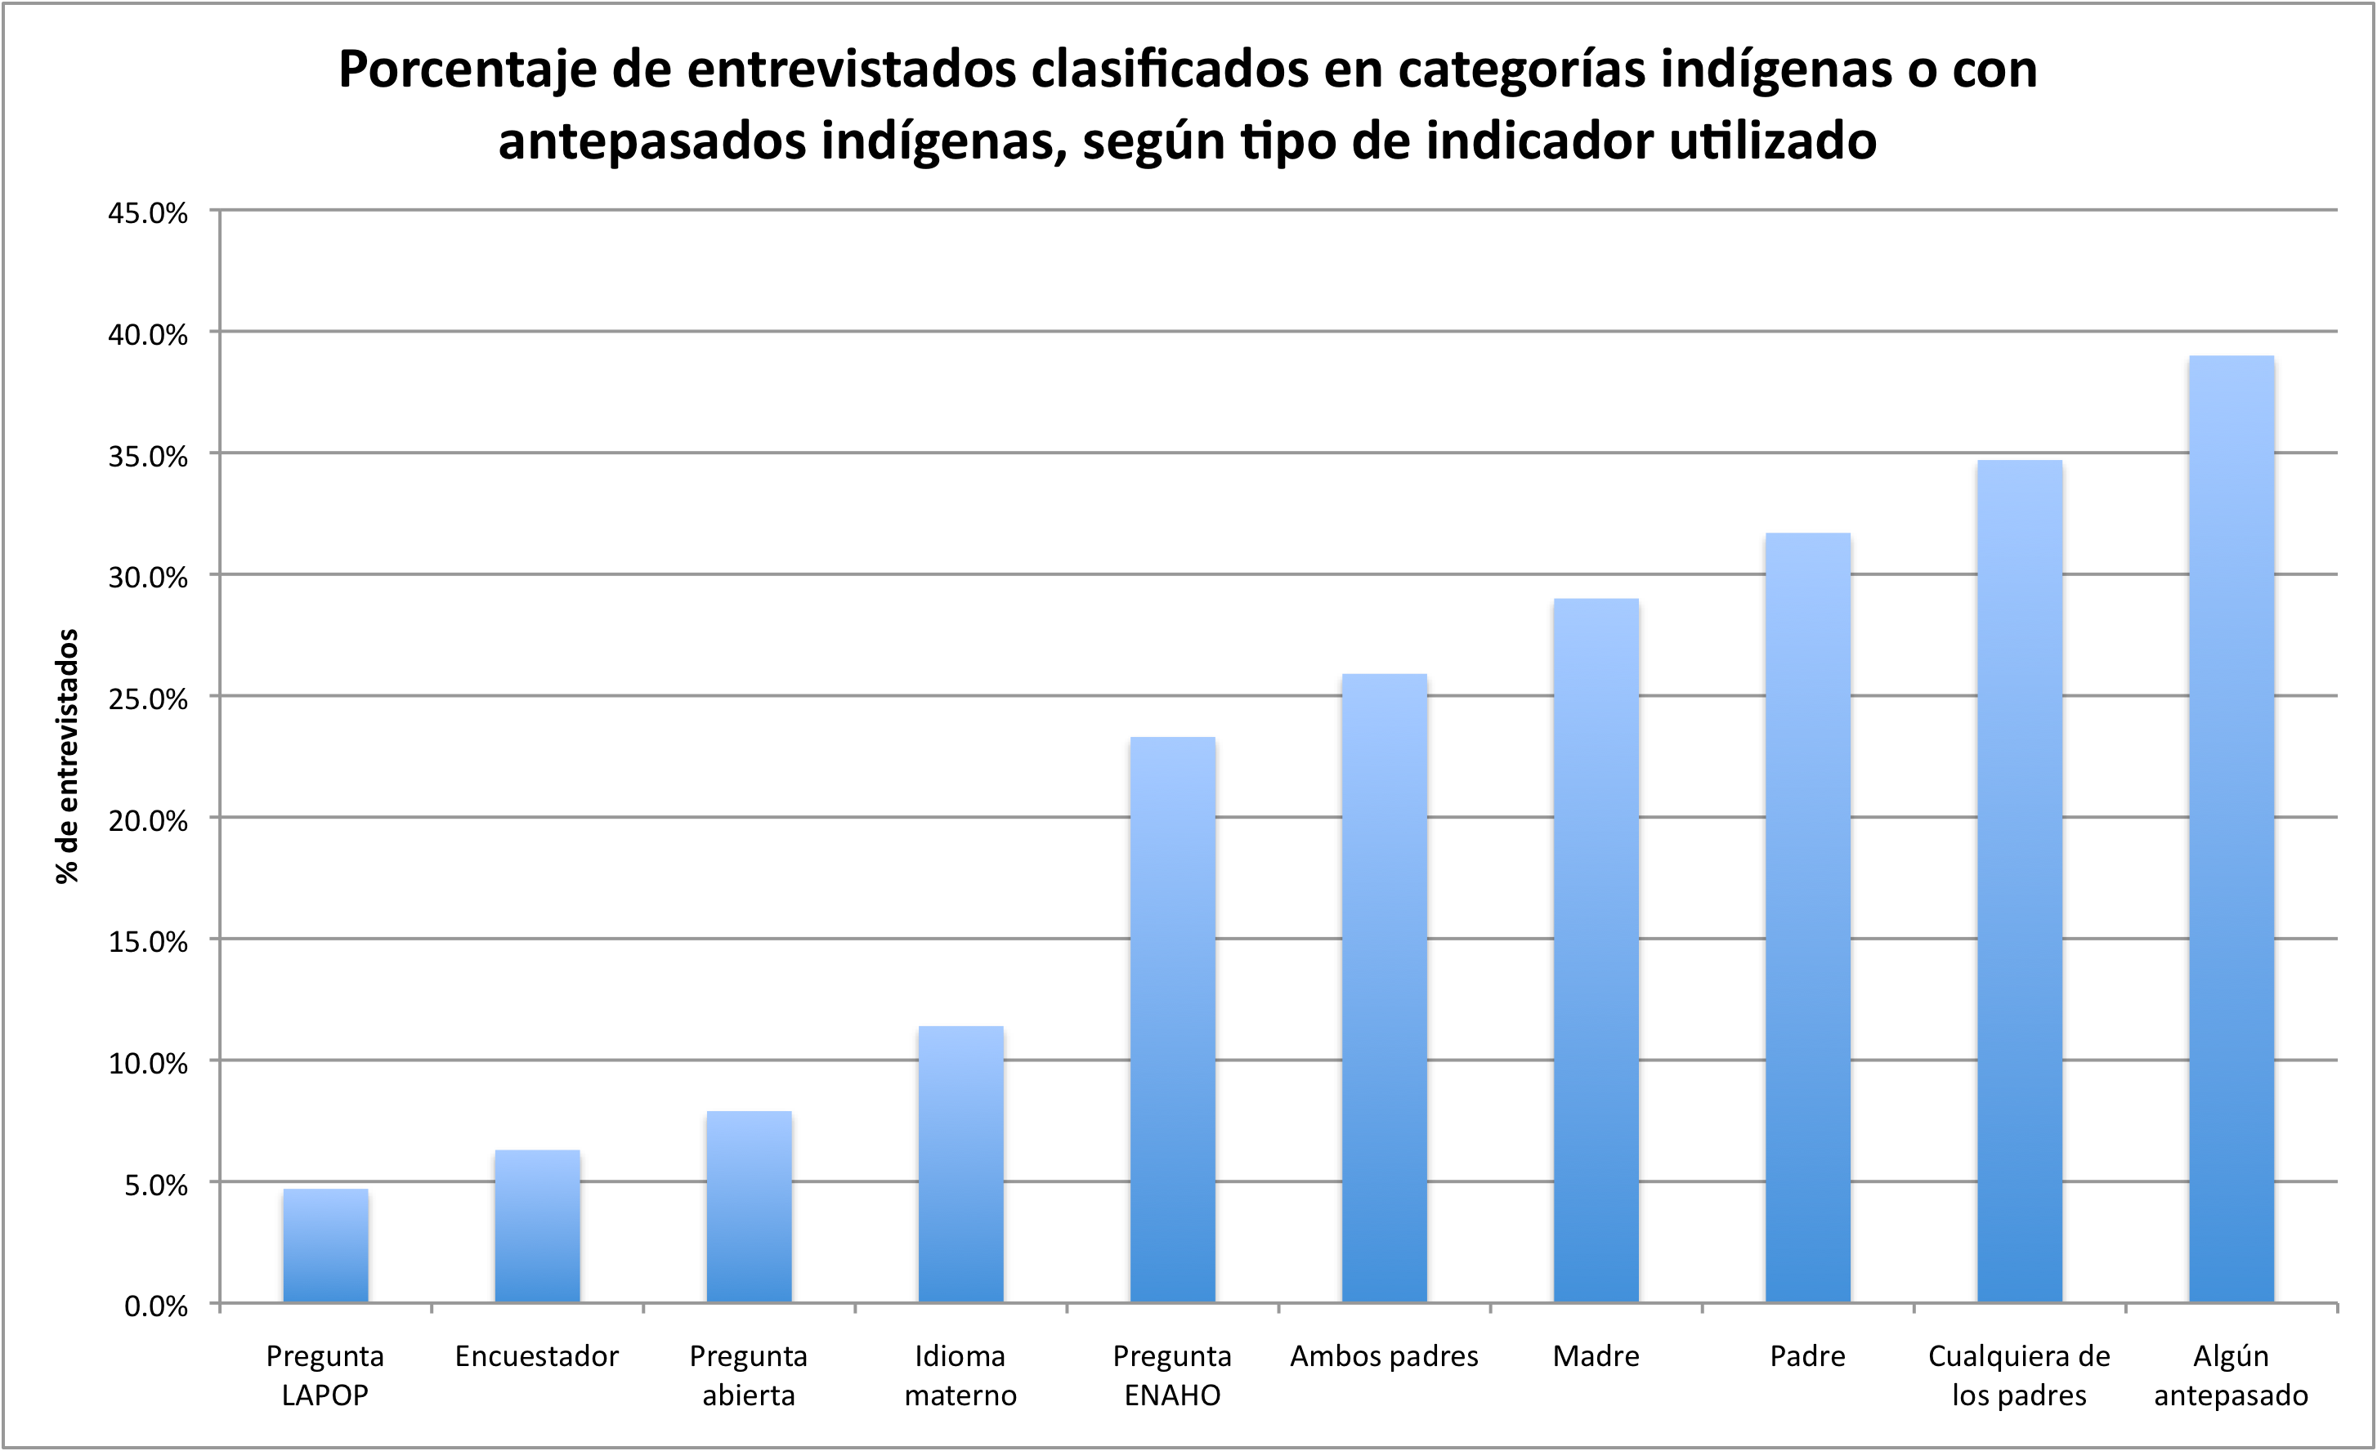
¿Cuántos indígenas en Perú?: depende…

Slide 14
Comparación entre Peru y Mexico y Entre Pueblos Indigenas
Notes:
Ecuador, with 7 percent indigenous, asked if they were indigenous before asking which group.

Slide 15
2. La Desigualdad Medida Por Categorías Etnoraciales de Tipo Censos son Inconsistentes e a veces, No Como Esperado
Indígenas Consistentemente los en maior Desventaja
Mestizos Están en mejor Situación que Blancos

Slide 16
Educational attainment and Identity

Slide 17
Educational attainment and Identity

Slide 18
3. La Desigualdad Por Color de Piel es Mas Consistente y en la Dirección Esperada

Slide 19
Educational Attainment
Skin Color

Slide 20
Household Income
Skin Color

Slide 21
Top Household Income
Skin Color

Slide 22
Bottom Household Income
Skin Color

Slide 23
Educational Attainment
Skin Color

Slide 24
Household Income
Skin Color

Slide 25
Top Household Income
Skin Color

Slide 26
Bottom Household Income
Skin Color

Slide 27
Skin color and educational attainment

Slide 28
Skin color and educational attainment

Slide 29
Skin color and educational attainment

Slide 30
Skin color and educational attainment

Slide 31
4. La Discriminación Racial/Por Color es Altamente Percibido Contra Si y Contra Otros en los Cuatro Países
5. La Mayoría de el Publico Apoya Movimientos Sociales Engráciales y Políticas Publicas que promueven gente afro-descendiente y indígena

Slide 34
Primary Ethnoracial Question in America’s Barometer
In most countries, Do you consider yourself white, mestizo, indigenous, black, mulatto or other?
In Spanish, Usted se considera una persona blanca, mestiza, indigena, negra, mulata u otra?
In Portuguese, Vôce se considera uma pessoa branca, parda, preta, indigena, ou amarela?

Slide 35
Auto IdenRacial Self-Identification is Loosely Related to Actual Skin Color

Slide 36
Ethnic identity and skin color, (1=Lightest, 11=Darkest)

Slide 37
Ethnic identity and skin color, (1=Lightest, 11=Darkest)

Slide 38
La Desigualdad Medida Por Categoría Tipo Censos son Inconsistentes e a veces, No Como Esperado
Indígenas Consistentemente los mas en Desventaja
Mestizos Están en mejor Situación que Blancos

Slide 39
Educational attainment and Identity

Slide 40
Educational attainment and Identity

Slide 41
La Desigualdad Por Color de Piel es Mas Consistente y en la Dirección Esperada

Slide 42
Skin Color and Educational Attainment

Slide 46
6. Race is Sui Generis throughout Latin America
Ethnoracial Inequality is Independent of Class/Socioeconomic Origins

Slide 47
Table for 23 Countries

Slide 48
National Differences in the Effect of Skin Color on Educational Attainment
Notes:
Coefficient plot
Each data point represents: color + countryXcolor

Slide 49
7. Latin Americans Recognize Discrimination against Blacks and Indgenous
For Dominants, Certainly More than the United States
Except Bolivia

Slide 50
8. Perceived Discrimination
Latin Americans often perceived discrimination by race, language or color and black, indigennous and dark skin persons report that they have been discriminated on those factors

Slide 51
Recent Publications
Flores, René and Edward Telles. 2012. “Social Stratification in Mexico: Disentangling Color, Ethnicity and Class.” American Sociological Review 77(3): 486-494
Telles, Edward and Liza Steele. 2012. “Pigmentocracy in the Americas: How is Educational Attainment Related to Skin Color? Insights 73
Telles, Edward and Denia Garcia. 2013. “Mestizaje and Public Opinion in Latin America” Latin American Research Review 48(3): October, 130-152
Telles, Edward and Stan Bailey. 2013. “Understanding Latin American Beliefs about Racial Inequality” American Journal of Sociology 118(5): August, 1559-1595
Telles, Edward E. and René Flores. 2013. “More than Just Color: Whiteness, Nation and Status in Latin America” Hispanic American Historical Review 93(3): March, 411-449
Telles, Edward and Tianna Paschel. 2014. Beyond Whitening: Color, Status and Nation in Latin Amerian Racial Classification” American Journal of Sociology
Pereira, Krista and Edward Telles. 2014.“Color, Racial Classification and Discrimination in the Health of Latin Americans” Social Science and Medicine
Telles, Edward E. and the Project on Ethnicity and Race in Latin America.2014. Pigmentocracies: Ethnicity, Race and Color in Latin America. Chapel Hill: University of North Carolina Press
Telles, Edward, René Flores and Fernando Urrea Giraldo, “Pigmentocracies: Skin Color, Census Ethnoracial Categories and Educational Inequality in Eight Latin American Countries” (under review)
Telles, Edward and Florencia Torche “Who is Indigenous in the Americas?” (in process)

Slide 52
FIN/FI/FIM/END

Slide 53
Various Census Questions and Categories: Mostly Self Identification
Questions:
Your color or race is…? (Brazil)
How do you consider yourself…? (Ecuador)
To what ethnic group (people) do you belong? (Guatemala)
According to your culture, people or physical features, are you or do you consider yourself…(Colombia)
Do you belong to the … culture? (Costa Rica)
In countries Venezuela and Paraguay, separate questions for afro-descendants and indigenous
Response categories:
For indigenous, indigena or as a particular ethnic group or language. Early Censuses used attire, diet or community
For Afrodescendants: negro, mulato, pardo, preto, raizal, etc.
Notes:
Concern about local variations in ianguage and terms used but also politics of course.
Census data is better of course but often not yet accessible. Project to begin to exploit it next year on the IPUMS.
Always self identification today

Slide 54
Ethnoracial Inequality

Slide 55
Educational Attainment
Identity

Slide 56
Household Income
Identity

Slide 57
Top Household Income
Identity

Slide 58
Bottom Household Income
Identity

Slide 59
Educational Attainment
Identity

Slide 60
Household Income
Identity

Slide 61
Top Household Income
Identity

Slide 62
Bottom Household Income
Identity

Slide 63
Pigmentocracy
(not picked up in ethnoracial census categories)

Slide 64
Color Palette
Notes:
Full range of color continuum
People have these in their heads
Skin color discrimination is widely recognized in Latin America
INTERVIEWER INSTRUCTIONS FOR USE OF COLOR PALETTE
Color Palette based on actual skin colors
Interviewers rated skin color of respondents before the interview
Skin color based on facial color
Interviewers directed to be familiar with palette and never show it to respondents
Interviewers explained why we are interested in skin color, especially as a meaningful social category that is rarely discussed
(Often used in U.S. surveys)
Cultural and Biological Race Mixture. Culture is consensus. I think one can easily argue that there was more much more biological race mixture across the population than the United States because
- high sex ratio during colonization
- more intermarriage in the twentieth century (based on Brazil data)
- relatively large black and indigenous populations and small white population so that chance of whites encountering nonwhites are greater (data on number of European immigrants?)
- relatively small number of European immigrants compared to US, even at height of mass immigration (except perhaps in Southern Brazil)
- wide skin color varation among the general population in all four countries
Mixture in black population (by far, largest part of nonwhite population) so that intermediate categories (mulatos) kept in black category but one drop rule kept it limited to that category while white category was considered pure (although sometimes violated).
Changing with large scale immigration of latinos and asians in the United States, so the Latin American experience may be important here

Slide 65
Take Away Points
Skin Color (External Identification) Matters
Skin Color Matters particularly in Some Countries
Ethnoracial Identification (Self- Identification) may be Less Important than Color
Ethnoracial Identification and Skin Color do not necessarily Overlap
Class Origins Also Matter
This is Work in Progress

Slide 66
Importance of Race Mixture (Mestizaje) in Latin America (vs Segregation in the United States)
1. mixture facilitated by demographic imbalance between colonizers and colonized
2. nationalizing elites made mixture central to national identity
3. little history of racial segregation (some in PR, Cuba and Panama)
4. often use mixed race categories
5. classification is more fluid and ambiguous
6. a national ideology of mixture widely accepted and downplays or denies importance of race and racial disadvantages AND THIS HAS AFFECTED RESEARCH ON THE TOPIC
Notes:
Need to include stuff on indigenous

Slide 67
OLS Models predicting SES in Ecuador
Note: Controls for Sex, Age, Community size, and geographical region. Household Income model also controls for education, age2, and PERLA/LAPOP survey.

Slide 68
OLS Models predicting SES in Brazil
Note: Controls for Sex, Age, Community size, and geographical region. Household Income model also controls for education, age2, and PERLA/LAPOP survey.

Slide 69
OLS Models predicting SES in Mexico
Note: Controls for Sex, Age, Community size, and geographical region. Household Income model also controls for education, age2, and PERLA/LAPOP survey.

Slide 70
OLS Models predicting SES in Colombia
Note: Controls for Sex, Age, Community size, and geographical region. Household Income model also controls for education, age2, and PERLA/LAPOP survey.

Slide 71
OLS Models predicting SES in Peru
Note: Controls for Sex, Age, Community size, and geographical region. Household Income model also controls for education, age2, and PERLA/LAPOP survey.

Slide 73
Brazil

Slide 74
Mexico

Slide 75
Colombia

Slide 76
Ecuador

Slide 77
Peru

Slide 78
Brasil: Porcentaje de entrevistados clasificados como negros o con antepasados negros, por diferentes indicadores

Slide 79
Colombia: Porcentaje de entrevistados clasificados como negros o con antepasados negros, por diferentes indicadores

Slide 80
México: Porcentaje de entrevistados clasificados como indigenas o con antepasados indigenas, por diferentes indicadores

Slide 81
Dominant Group
White
Mestizo
Mulatto
Mestizaje
Indigenous
Black

Slide 82
Perú: Porcentaje de entrevistados clasificados como indigenas o con antepasados indigenas, por diferentes indicadores

Slide 83
Perú: Porcentaje de entrevistados clasificados como negros/mulatos, por diferentes indicadores
% of respondents

